Slide 1
Rigorous peer-reviewed journal publication to influence policy
Chris Barrett, Cornell University
31st International Conference of Agricultural Economists
August 18, 2021

Slide 2
Why publish in journals?
Peer reviewed publication is especially important for policy research.
1. Dissemination
“Grey” lit hard to find, and even if found, often excluded from reviews. Peer reviewed pubs have broader reach.
2. Quality control
If you want non-specialists to use your findings, get experts
to check carefully for errors. Imperfect but better than not.
3. Credentialing
Policy advisers look at pub records to authenticate reliability of research findings.
So subject all of your research to peer review and aim to publish it all. Keep these three purposes in mind!

Slide 3
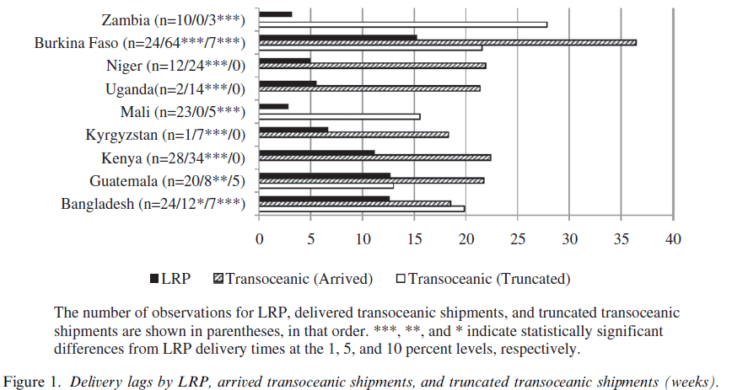
Ex: US food aid policy
Ex 1: 2008 Local and Regional Procurement (LRP) Pilot Program
Created by 2008 Farm Bill based on researcher recommendations.
Cornell-NGOs research partnership (LRP Learning Alliance) set to rigorously assess policy (don’t rely just on Congressionally mandated consultant).
Conclusively answered questions that lingered during the 2008 Farm Bill debates ... White House invoked the findings for 2014 Farm Bill clinching several policy debates (but lost the political ones!).
(See Lentz et al. Sep. 2013 World Development special issue)
Source: Lentz, Passarelli and Barrett (WD 2013)

Slide 4
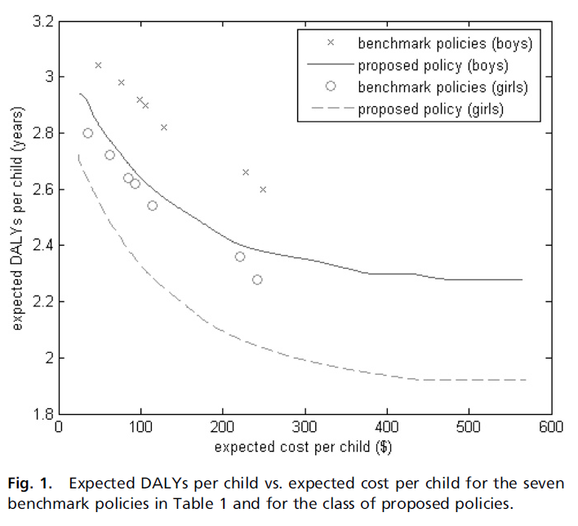
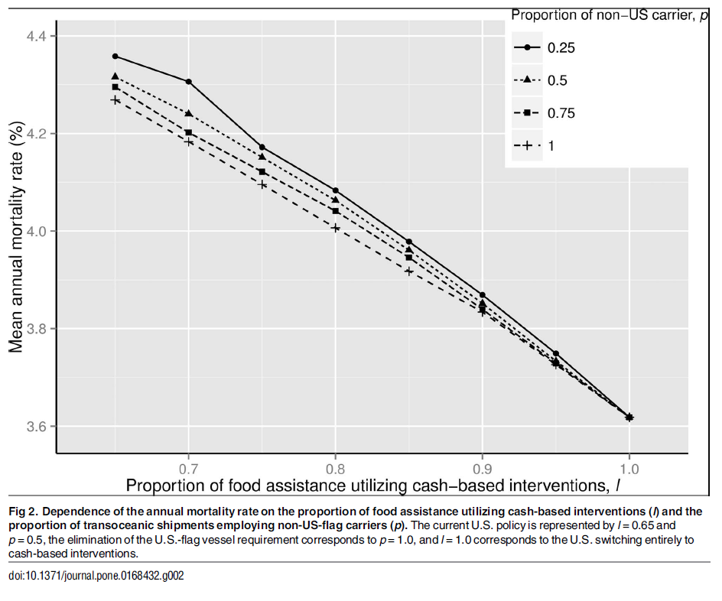
Ex: US food aid policy
Subsequent analyses show cash and RUTF interventions, targeting on both HAZ and WHZ, and relaxing cargo preference can save children’s lives. Has influenced humanitarian food assistance programming.
(Sources: Yang et al. PNAS 2013; Nikulkov et al. PLoS ONE 2016)

Slide 5
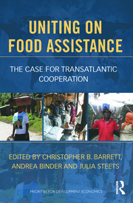
Ex: US food aid policy
May need/want to supplement journals with less technical, integrative essays or books that pull it all together. But journal papers form foundation.

Slide 6
A caution
Seemingly clever research that’s wrong can do damage.
Example: Nunn and Qian (AER 2014) claim US food aid shipments cause longer, more deadly conflict in recipient countries. Widely reported/discussed, incl. in DC; hugely important, if true.
Problem: They mischaracterize US food aid policy. But a model with proper timing and subsamples yields the same result … why?
Deeper (and underappreciated) econometric problem: panel IV estimation vulnerable to spurious regressions due to common cycles in time series component.
Corrected finding: Once one accounts for the trends, NQ results disappear. Indeed, NQ results perfectly consistent with a model in which food aid reduces conflict. (Christian and Barrett in 2nd round review)
Use research credentials judiciously and subject work to good peer review.

Slide 7
Summary
Empirical food policy research can – and has – significantly influence food policy. Good research matters! (And bad research can cause damage.)
Peer-reviewed journal publication matters to policy influence.

Slide 8
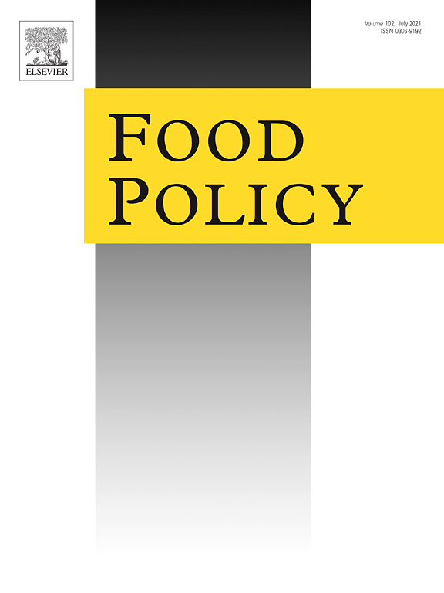
Consider Food Policy
At Food Policy, we welcome rigorous, policy-oriented research and promise careful, prompt peer review

